Slide 1
Limits of Preparedness

Slide 2
How does scenario exercise differ from risk assessment or risk calculation?

Slide 3
Reflection: what are the limitations of preparedness?

Slide 4
Example: Preparedness for Pandemic Influenza

Slide 5
“The diversity of avian influenzas that circulate in the domestic poultry of this region [southern China] suggests that it may be important as a point of origin for pandemic viruses.”
Kennedy Shortridge and CH Stuart-Harris (virologists), 1982

Slide 6
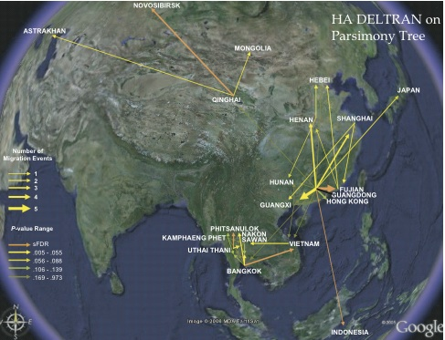

Slide 7
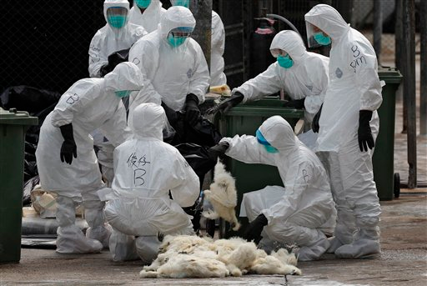
Source: “China halts poultry trade after new H7N9 cases.” Medical Xpress, January 14, 2014

Slide 8
Farmers’ ‘risks’
Market
Disease
The ‘greater environment’

